Slide 1
FTIR 101 and FTIR Compliance-Based Methods
Bryan Benaway
Spectrum Environmental Solutions
May 25, 2017
Notes:
Call out why you are not Steve Hall and why you are not AECOM

Slide 2
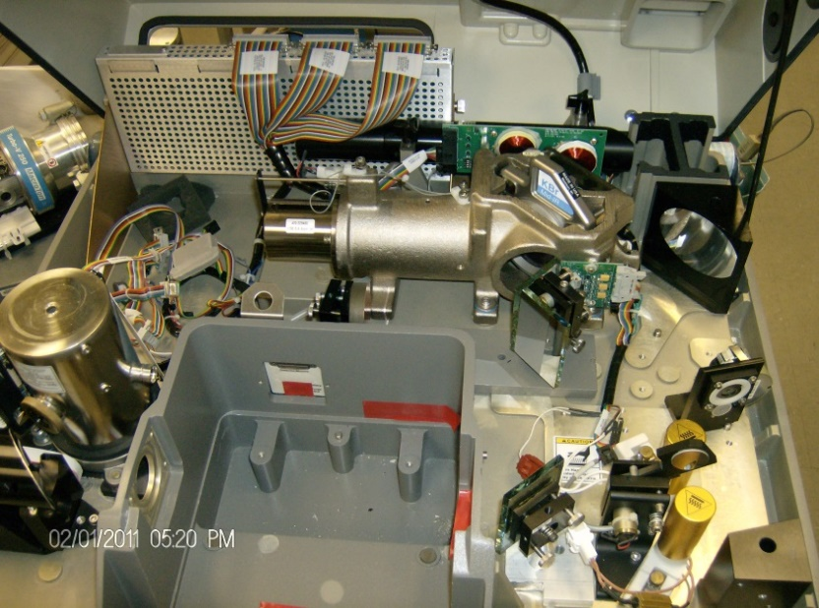
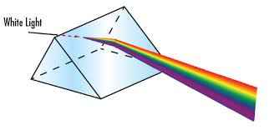
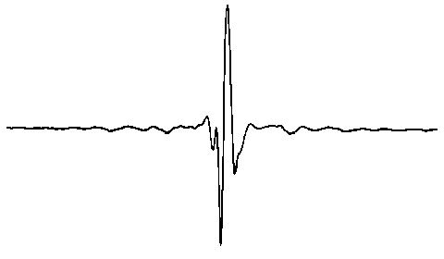
FTIR 101 –Background/Theory
Invented in 1887 by Albert Michelson
1907 Nobel Prize in Physics
Blackbody IR Radiation is “Organized” into a Usable Pattern by Michelson Interferometer
  Interferogram FT Spectra
Notes:
Theory in very general terms
Interferogram = interference pattern = perform FFT and a few other functions ya get absorption spectrum
Thing to remember Organizes the light

Slide 3

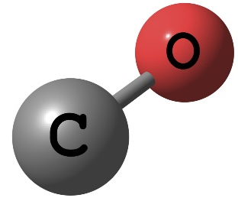
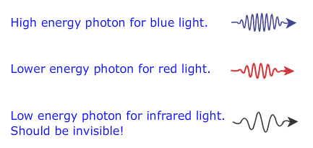
Deciphering the “Black Box” of FTIR
PHOTON DISSAPEARS!
ABSORBANCE
photon
carbon monoxide
passes straight through
object
Reflected
Notes:
Heard that so many times… so what is actually happening inside this “black box”
Well, let’s start with a photon [click]. Our photon is traveling along through space at the speed of light, totally happy until it comes across an object [click]. In this case a cuddly teddy bear.
Now, 3 things can happen to our photon. Number 1 [click], our photon passes straight through, totally unaware there was ever a teddy bear in his path [click]. Possibility number 2 [click], our photon is reflected off of the object affectively change it’s direction [click], and finally [click] our photon disappears! This phenomenon is called [click] ABSORBANCE! And this is the physical phenomenon in which FTIR operates [click], only difference for us is we replace the teddy bear [click] with a chemical species, in this situation a carbon monoxide molecule [click to next screen]

Slide 4

Deciphering the “Black Box” of FTIR
frequency
Notes:
FTIR is slightly more complicated in that we are not dealing with one single photon at one single frequency of light [click] rather we are dealing with an enormous amount of photons all with widely differing frequencies, all at the same time. Here we have a rainbow with it’s characteristic color separation. The different colors we observe are actually a result of these photons carrying different frequencies. As you can see, the red photon has a much smaller frequency than the blue photon.

Slide 5
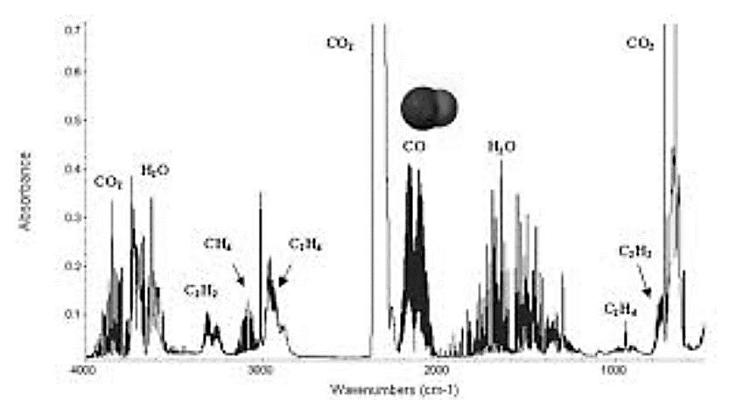
Deciphering the “Black Box” of FTIR
amount of light lost (absorbance)
frequency
Notes:
Differently arranged matter absorbs different frequencies of light in a unique and repeatable way! This allows us to distinguish between compounds and measure their molecular density by recording these regions of absorbance!

Slide 6
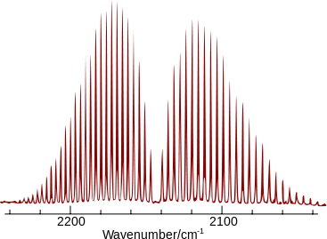
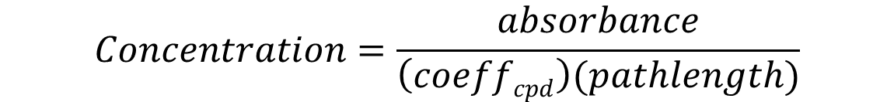
Deciphering the “Black Box” of FTIR
$$Concentration∝absorbance$$
$$Concentration=\frac{absorbance}{\left(coeffcpd\right)(pathlength)}$$
constant
Notes:
Lastly, a mathematical relationship known as the Beer-Lambert law relates the amount of absorbance to the concentration of the sample. [click] Each compound’s absorbtivity coefficient is dependent only on wavelength. If the light path’s length of travel through the sample was the same for each spectrum, then the concentration difference between the two is directly related to the magnitude of the absorbance peaks. If we have reference spectra – ftir spectra collected of a species at a known concentration and pathlength (and temp and pressure) - then we can compare the refernces to our sample spectra to identify the quantify the compound’s presence.

Slide 7
Advantages and Disadvantages
Pros
Real-time measurements, processing and display
Simultaneous quantification of many compounds
Totally automated after initial setup
Remote access capability
Minimal calibration required
Uses full intensity of signal and full IR bandwidth at once, unlike CO CEMs for instance.
Sensitivity (low ppb DLs)
Stores spectra electronically – *Never lose sample
Cons
Easy to obtain inaccurate data if not analyzed correctly
Skilled spectroscopist needed for proper analysis and validation of results
Existing FTIR-based EPA methods are somewhat complex and often require adaptation.
Extraction of reactive components can be challenging
Requires routine maintenance
Mobility - heavy and bulky
Relatively expensive
*Never lose sample
Notes:
Last bullet on Pros will resonate – FTIR 400-5000cm range – CO~5-10cm thus multicomponent analysis
CO monitor directs IR through a slit so lose a lot of signal
Profound physical evidence tying concentration results – 2nd opinion
Never lose sample is pro and con as can help or incriminate

Slide 8
FTIR-Based Compliance Methods
EPA Method 320 – Measurement of Vapor Phase Organic and Inorganic Emissions by Extractive Fourier Transform Infrared (FTIR) Spectroscopy
ASTM D6348-12 Standard Test Method for Determination of Gaseous Compounds by Extractive Direct Interface Fourier Transform Infrared (FTIR) Spectroscopy
EPA Method 318 Extractive FTIR Method Measurement of Emissions from the Mineral Wool and Wool Fiberglass Industries
EPA 321 Gaseous Hydrogen Chloride Emissions at Portland Cement Kilns by FTIR
Notes:
320 is the one everybody immediately goes to – VERY CONFUSING 6 MDL / Uncertainty calculations – poorly written – And OLD – Although undergoing update / revision process right now.
ASTM has been recognized by EPA as a suitable alternative as stated in many promulgated rules (RICE MACT ZZZZ)
321 basically 320 with subtle difference but for cement kilns
Separate general data taking guidelines for FTIR also exist and are referred to as well as guidelines for open path configurations

Slide 9
EPA 320 Overview
“Persons unfamiliar with basic elements of FTIR spectroscopy should not attempt to use this method”
  “This Method is self-validating provided that results meet the performance requirement of the QA spike…and the results from a previous method validation study support the use of this method in the application”
Notes:
1st sentence Good for guys like me that EPA recognizes difficulties of FTIR monitoring Basically a lot to (e.g. monitoring procedures monitoring tranmittance %, interferograms, etc) it I’ll touch on most applicable
Mentioned multiple times implies an extensive Method 301 validation. What is meant by Method? Could be costly but is not directly referenced as a func. of analysis method or company. Fortunately this has been done for most of the gas matrices encountered in the semiconductor world. Significant expense-took PhD ~6 days to complete (not including setup) in one SEMATECH Study.

Slide 10
EPA Method 320 and ASTM D6348-12 Required QA Data
EPA Method 320
CTS – before and after each run – the peak absorbance must remain within 5% of mean
  Used to verify line position and resolution
  CTS standard must have at least 1 absorption band within 25% of wavenumber position of analytical regions of interest.
  Commonly used to verify cell pathlength for adjustable path cells
QA Spikes – 3 independent samples before testing
  Performed into extracted sample at no more than 10% of extracted volume.
  Spiked concentration should be at or near native levels
  70-130% recovery criterion
Response Time
  Calculated from QA Spike
  Time to reach a steady state
ASTM Method D6348-12
CTS - before and after entirety of testing or at beginning/end 0f day
  RPD of 5% or less
  Commonly to verify cell pathlength for adjustable path cells
QA Spikes -
  Direct inject within 10% or 5ppm (for reactive analytes) of certified concentration
  into extracted sample at no more than 10% of extrconcentrationacted volume.
  Spiked should approximate (or be within ±50% of) the native levels
  70-130% recovery criterion
Response Time
  Verified 3 ways – mechanical response time, equilibrium response and zero test
  Time to get to 95% of cylinder or native values
Notes:
Mechanical response = CTS through sample system
Equilibrium or System Response = most reactive analyte through system
Zero = up and down scale of native compound (usually water or CO2) to 5% of native (down scale) when N2 injected and 95% (upscale) after N2 off

Slide 11
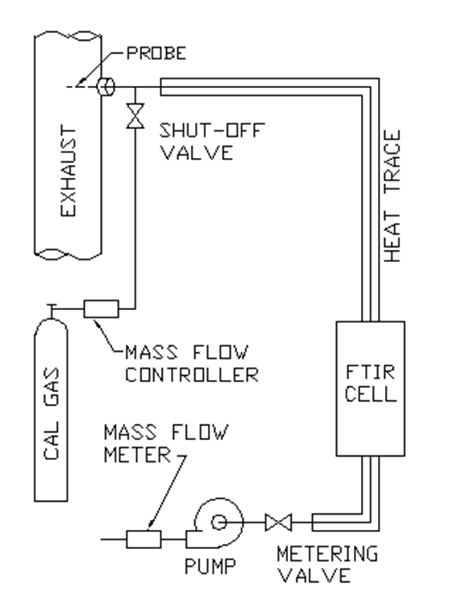
Typical 320 Sampling Setup
Notes:
Thing to note is that weather QA or Validation, spiking into extracted gas.
320 requires spike flow is no more than 10% so as not to change sample matrix significantly. Want the internments to affect target analyte naturally.
Need sufficient concentration in cylinder to see change in native
Native concentration must be stable
3 independent spikes

Slide 12

Leak Checking
ASTM Method D6348-12
Not required if mechanical response test performed in the field and passes.
  Must run Mechanical Response test at similar pressure/vacuum conditions as during testing
Only performed pre-test!
No other guidance in ASTM Method regarding leak checks.
  As a rule, we perform pre- and post-leak checks of the entire system using 0-1 (or smaller) lpm rotometers attached on the pump side of the FTIR.
  Passing criteria < 0.2 lpm
Notes:
Mech Response test is running CTS through the entire sample system
Similar pressure – cant hammer through system such that you increase sample system pressure form high delivery pressure.

Slide 13


Leak Checking
EPA Method 320
Independent FTIR cell and sample system leak checks and only required pre-test
  Evacuate sample system to terminal vacuum and monitor rotometer on pump side of FTIR. Flow out must be <0.2 lpm –Be sure to use a rotometer with adequately resolved graduations.
  Evacuate FTIR cell to terminal vacuum and isolate from the pump. Monitor the pressure increase over 2 min. Calculate % volume leaked (%V_{L}). %V_{L must} be less than 4% of the sample volume (<4% dilution).
Notes:
Crazy and unknown reason. Basically if entire system leak checked and <0.2 or 4% then should be good.
Using a 0-15 lpm rotometer to demonstrate <0.2lpm is probably not measurable

Slide 14

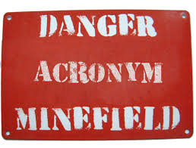
Minimum Detection Limits
M320 has ~6 way to determine DL/uncertainty but only considers 4 ways
  OFU=Max(FMU,FCU,FAU,FRU)=FMU
Alternate is 3*Standard Deviation of a data set containing the sample matrix but absent of the analyte
  Straight from statistics books and represents >99.7% confidence level
Notes:
OFU= Overall Fractional Uncertainty is the max of all other uncertainties calculated and is the DL
Lots of acronyms but DL will almost always be the Fractional Model Uncertainty (FMU) as it is based on spectral residual which incorporates interference effects
We use 3*STDEV of a population whenever we can – most representative and understandable – translates to about a 99.7% certainty
FCU Fractional Calibration Uncertainty
FAU Fractional analytical uncertainty
FRU Fractional reproducibility uncertainty

Slide 15
NEA Spectra and their value
NEA=Noise Equivalent Absorbance = Zero Spectrum
    Used to calculate RMS and peak-to-peak instrument noise.
Required for both EPA 320 and ASTM D6348 Methods
Demonstrates that FTIR is properly aligned and has no other serious issues.
Main use is to calculate a Noise-based Minimum Detection Limit
  The analyte concentration at which its peak absorption is equal to the absorption due to the inherent noises from the instrument
Notes:
Limited value with one noteworthy use
Zero spectrum made by ratioing/subtracting consecutive spectra of the same gas

Slide 16
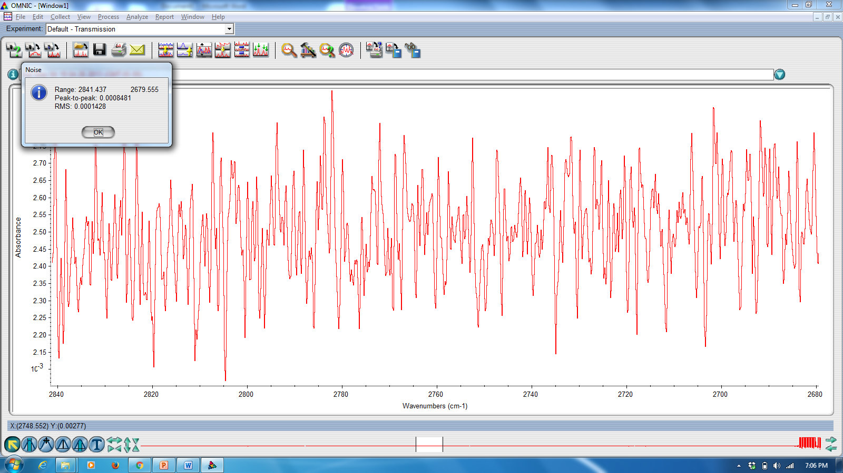
System Noise on 28m Pathlength System RMS = 0.0001428
Notes:
This is same frequency region as previous slide and is where strongest formaldehyde absorption are
This is a good noise value for a 28m pathlength

Slide 17
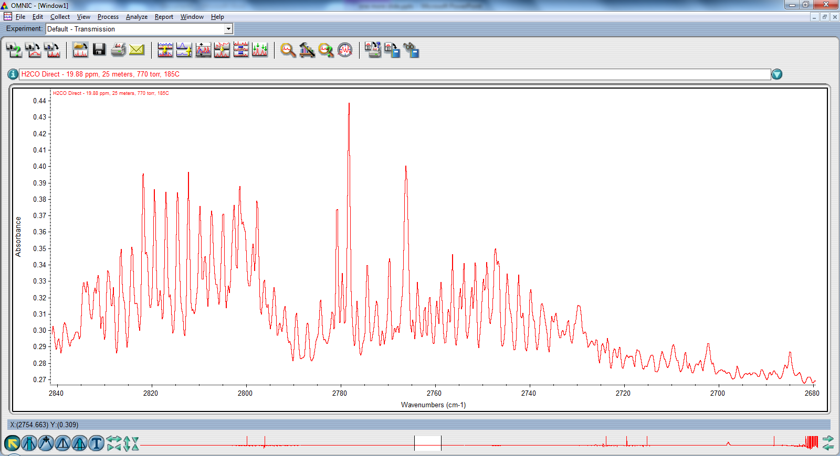
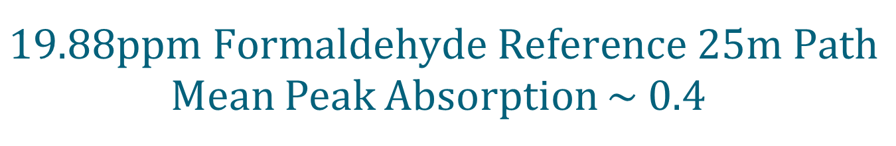
$$19.88ppm Formaldehyde Reference 25m Path$$
Mean Peak Absorption ~ 0.4

Slide 18
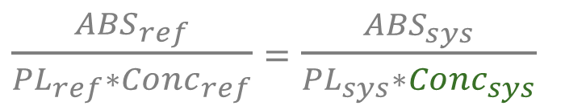
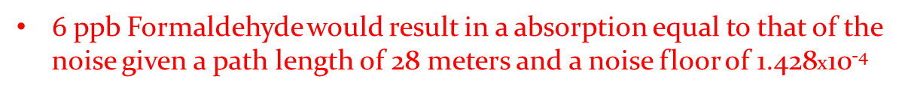
$$Noise−based Minimum Detection Limt$$
$\frac{{ABS}_{ref}}{{PL}_{ref}∗{Conc}_{ref}}$ = $\frac{{ABS}_{sys}}{{PL}_{sys}∗{Conc}_{sys}}$
Best case DL occurs when ABS_{sys} is minimized down to the instrument’s noise floor, the noise-limited minimum detection limit NMDL
$Concsys =\left\lfloor \frac{1.428x10−4}{\left(28m\right)}\right\rfloor \left[\frac{\left(25m\right)∗19.88ppm}{0.4}\right]$ ≈ 6 ppb = NMDL
$6$ppb Formaldehyde would result in a absorption equal to that of the noise given a path length of 28 meters and a noise floor of 1.428x10⁻⁴
Notes:
-6ppb =noise we like to go 3x it so 18ppb would be the DL
One thing of note here is that if the FTIR were a MKS 2030, the most common FTIR out there, the 3*noise DL would be 105ppb at best as the MKS usually has greater noise than
The FTIR used here. We have commonly seen ~150-200 ppb for MKS. So take caution if someone was using it to comply with turbine MACT where 91ppb is the criterion.

Slide 19
EPA 320 and ASTM Analyte Spikes
Both the QA and validation spikes are performed by injecting gas standard into the extracted sample
320 QA Spike(s)
  Performed in triplicate, at onset of project, for each Analyte
  Use assumes validation has been performed
ASTM QA Spikes – One required at onset per project
320 (301-like) Method Validation
  Performed once per source
    12 spiked and 12 unspiked pairs
  More extensive statistical validation
    Used to determine applicability, t_{stat,} systematic bias, precision and correction factor
  Not required for ASTM Method
Common practice to use a tracer to calculate dilution
Notes:
QA Spike-performed before in TRIPLICATE before sampling good practice to do one after although not required
Meth Val 301 validation ideally perform individually bur can be performed w/ a cocktail
CF important for this application due to low DLs required
Although the spikes for each are identical in practice both can be required…
Can you use tracer since most widely used tracers are F-GHG for their stability and inert nature . . also common properties of GHGs.
Interesting dilema as each GHG also meets criteria for a tracer. We use SF6 and CF4 in other industries…could also use flow to determine DF

Slide 20
QA Spiking Procedure
Directly inject standard into FTIR cell and record F-GHG and tracer concentrations (Analyte_{dir} & Tr_{dir})
Spike standard into extracted flow (3 times per 320, once per ASTM) & record analyte and tracer concentrations
  Spike flow < 10% of extracted flow
Calculate dilution factor DF=Tr_{spike}/Tr_{dir}
Calculate expected concentration
  CE = DF*Analyte_{dir} + (1-DF)*Native
Acceptance Criterion is ± 30% of CE
Notes:
Spike Standard +/- 2% accuracy
Noteworthy Tr_{spike}= diluted spike conc. Use direct injection results not bottle cert results. Not true spike recovery based on expected concentration not +/- 30% of spiked value—would be more stringent.
Could calc dilution using characterized flows but not stated in 320-Curt did though
This, and the absence of leaks, result in virtually indisputable evidence that system’s results were of adequate quality.
If these spikes pass you can go forward with sampling-not gona bore ya with those procedures as most FTIR folks know them.

Slide 21
The End
Thank You,
Questions?

